Slide 1

Azure webinar series
Migrate your .NET web applications to Azure for scale and agility
Notes:
Replace cover image: go to Format Background > Picture or texture file
Adjust gradient: go to View > Slide Master > Adjust shape fill options

Slide 2
Welcome

Slide 3
Meet our speaker
Jay Schmelzer
Director, Developer Division Customer Engagement Team
JaySch@Microsoft.com
Notes:
Speaker image: Insert/Paste image > Picture Format > Crop > Aspect Ratio 1:1 > Crop > Crop to shape (circle) > Resize to template

Slide 4
Agenda
Customer expectations vs. reality
.NET Momentum & Roadmap
Migration & modernization strategies
Migration & modernization case studies

Slide 5

More than any other factor, customer experiences determine whether companies thrive and profit, or struggle and fade.
– Forrester Research
Notes:
Why are we talking to you about apps? It’s not just our desire to geek out, it’s about the bigger picture of how technology and business play together. Forrester Research captures it well by saying that ultimately, it’s the customer experience that makes or breaks a product, and that often boils down to apps.
More than any other factor, customer experiences determine whether companies thrive and profit, or struggle and fade.
For many companies this means status quo is not strategy.
---------------------------
Reference
http://blogs.forrester.com/harley_manning/12-09-14-when_it_comes_to_total_returns_customer_experience_leaders_spank_customer_experience_laggards
Over the course of the five-year period, the customer experience leaders spanked the laggards in stock performance. The leader portfolio had a cumulative total return of +22.5%, compared with a -46.3% decline for the laggard portfolio.

Slide 6
Your customers have high expectations
Speed
79% won’t return to a slow website
Personalization
38% won't call again if they have to repeat themselves
Cross-device
65% get frustrated with an inconsistent experience
Notes:
To put “customer experience” into perspective, here are some features that can make or break app experiences today. And the bar for what customers expect keeps moving as technology changes. Speed, personalization, and cross device are some of the examples of what end users expect of your apps today.
---
Just like how customer experience have become critical to the success , your customers expectations have also increase
Your customers have really high expectations.
1) They want to know them and be aware of their context and needs, make it easy to engage with your business whether they are looking to learn more about a product or service or buying from you. And do so in a way that is consistent where they are experiencing your business whether they are home at work on the go. And they want an experience that is fast - milliseconds not minutes is the new measure of wait times.
and fast
References:
https://www.glassboxdigital.com/
2) Accenture Global Consumer Pulse 2013
3) https://blog.kissmetrics.com/speed-is-a-killer/
4) 29% said they are were less likely to buy products if they receive irrelevant marketing (1)
Janrain and Blue Research (http://janrain.com/about/newsroom/press-releases/national-study-shows-consumers-abandon-brands-online-out-of-frustration-with-mistargeting/)
http://www.huffingtonpost.com/entry/dont-let-irrelevant-messaging-cause-your-customers_us_584eddf9e4b0151082221db6

Slide 7

What does it take to realize these benefits?
Notes:
So how do you build or update your apps to solve for these new requirements and to help your business thrive and stay competitive?

Slide 8
Open & Scalable Cloud Platform
Data-driven Intelligence
Cross-platform Experiences
Continuous Innovation
Notes:
For you to achieve these benefits you need an Open & Scalable Cloud Platform to scale up or down in line with your business needs, Data-driven Intelligence that you can weave in in every touchpoint you have with your customers and provide a personalized experience starting from initial engagement to retention, set of tools or services that set up your team to provide consistent cross-platform Experiences and drive continuous innovation. Especially, with public websites and apps, things change often so it is really important to have the platform support continuous innovation.
Microsoft provides all of this as one integrated platform and in most regions so that you can bring data closer to your customers, with un-matched hybrid capabilities so that you can easily store and retrieve your data from either on-premises or from within cloud.

Slide 9





Azure is for all your web apps
Code…
.NET
Use the framework, container, or OS of your choice on a fully managed platform.
.NET, Node, Java, PHP, Ruby, Python
Container…
Microsoft Azure
OS…
Notes:
Azure is for all your apps, regardless of technology stack or preferred deployment method

Slide 10


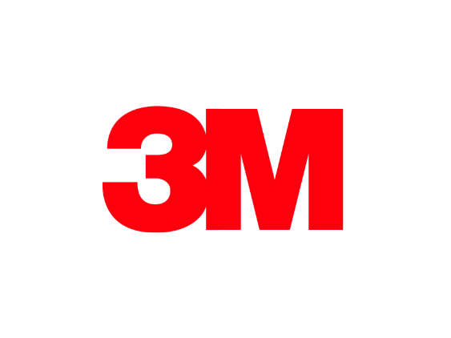





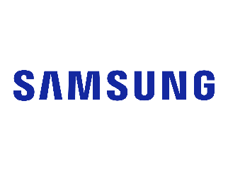

















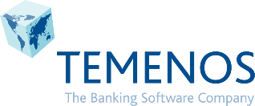



>90% of Fortune 500 use Microsoft Azure
Notes:
And you are not alone – there’s a tribe of customers who have already chosen Azure and continue to do amazing things with our platform and reap the benefits and speed of our technology. We’ll go into some examples later in this talk.

Slide 11
.NET Momentum & Roadmap

Slide 12







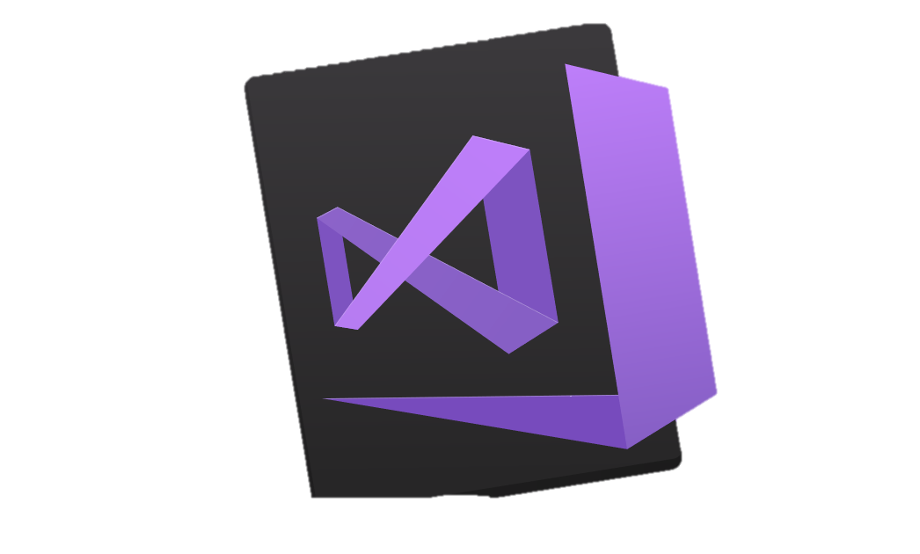
Your platform for building anything
Desktop
Web
Cloud
Mobile
Gaming
IoT
AI
.NET
Visual Studio
Visual Studio for Mac
Visual Studio Code
Command Line
Your editor
Notes:
You can build anything with .NET. We’ve made significant investments in .NET over the years as well as unifying the ecosystem to support building literally anything. From desktop to gaming to the cloud, .NET is a general-purpose programming platform that enables all kinds of scenarios. Once you learn one, you can easily pick up another.
<CLICK>
What’s more, you can also use your favorite tools and editors to build .NET apps – or use Visual Studio, Visual Studio Code or Visual Studio for Mac.

Slide 13
.NET
Open source & cross platform
750K
+1M
.NET Core developers
New .NET developers
in last year
Notes:
We’re seeing incredible growth in .NET. .NET Core, the open source, cross platform and high-performance implementation of .NET, now has over 750K developers. And the entire platform has grown over a million developers worldwide in the last year. These developers use .NET every day to power startups, enterprises, consultancies… really, to power the world. And that number is growing.

Slide 14
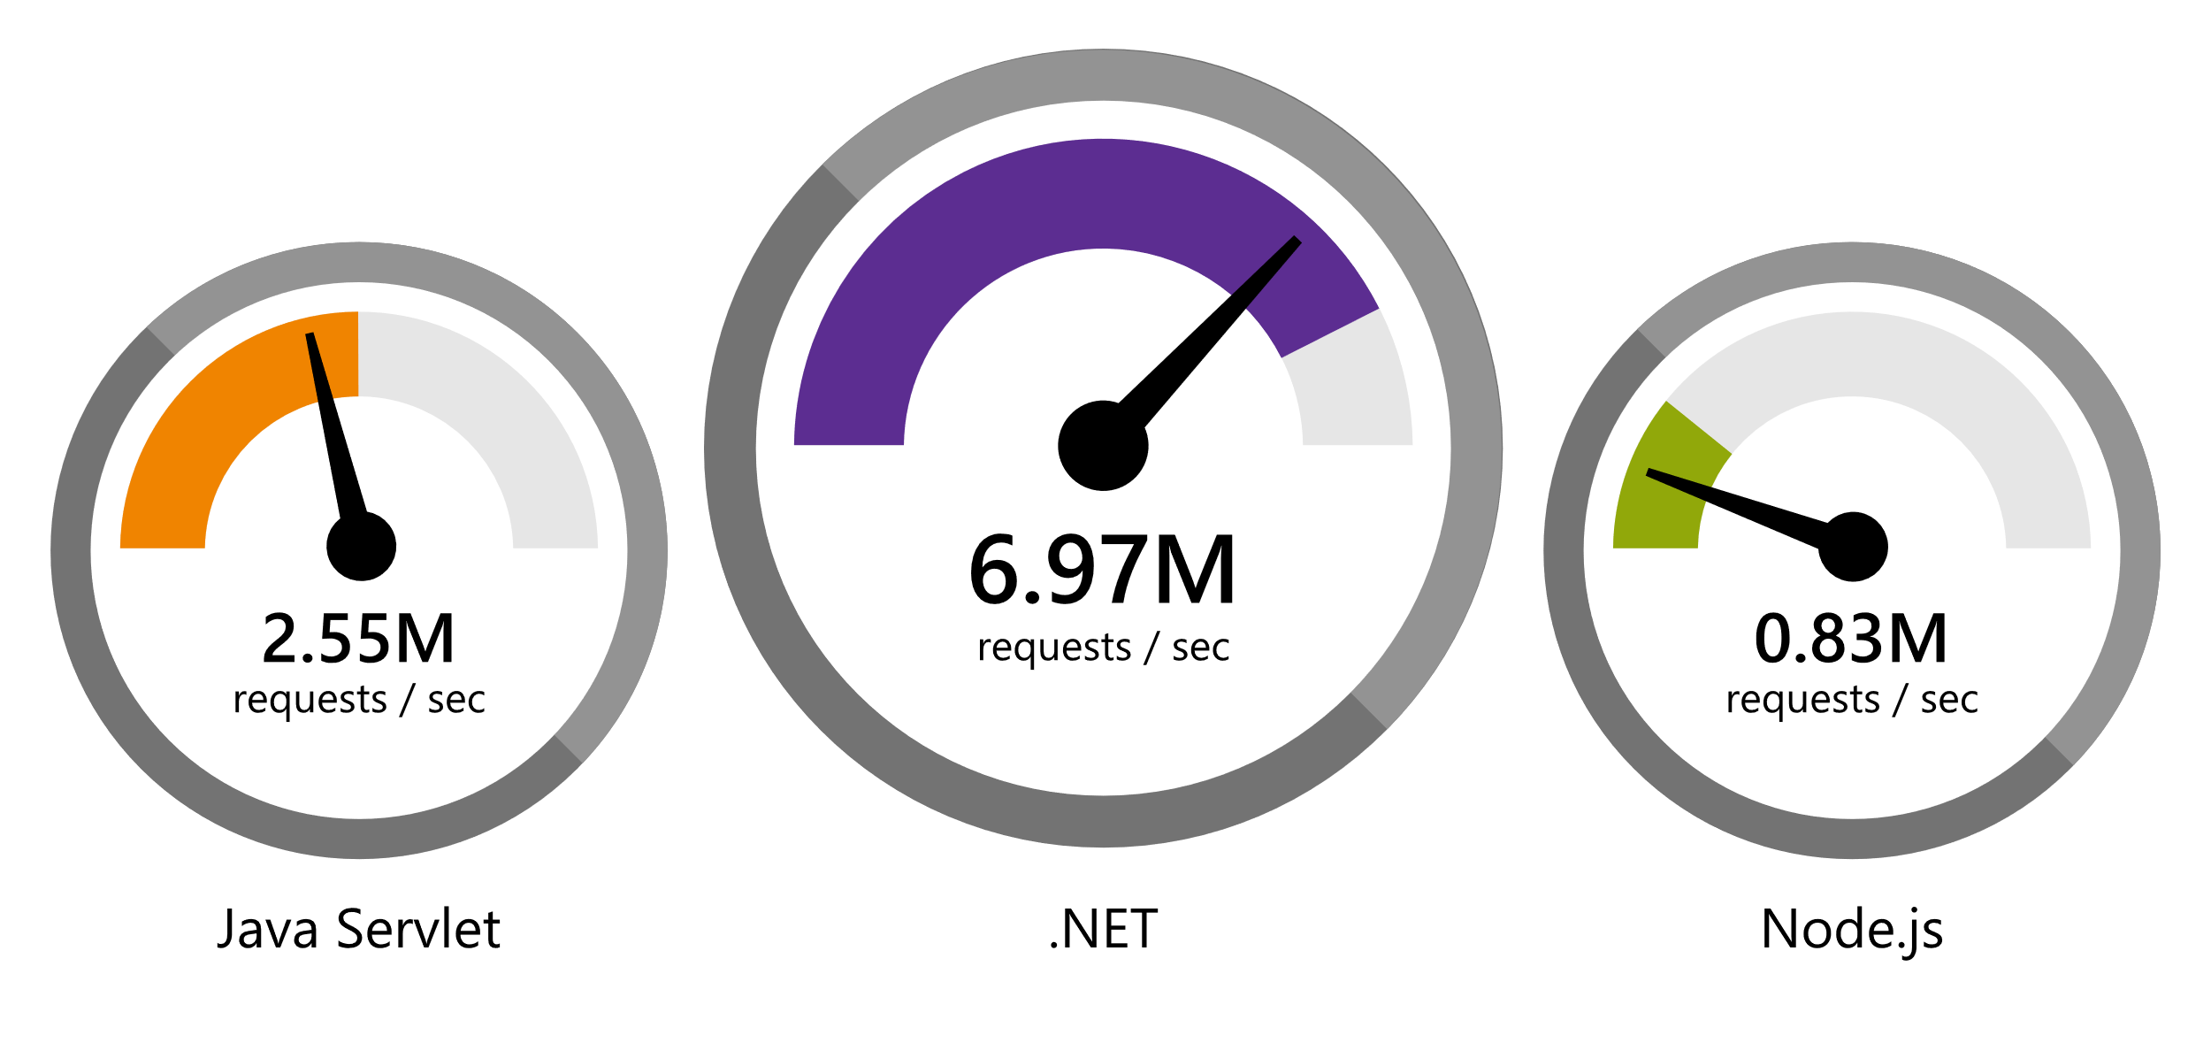
.NET
Faster than any popular framework
“Using the same-size server, we were able to go from 1,000 requests per second per node with Node.js to 20,000 requests per second with .NET Core.“ — Raygun
www.dot.net/customers
Data sourced from official tests available at TechEmpower Round 16.
Notes:
We’ve made significant investments in the platform especially in terms of performance.
The popular TechEmpower benchmark compares web application frameworks with tasks like JSON serialization, database access, and server side template rendering - .NET performs faster than any other popular framework.
https://www.techempower.com/benchmarks/#section=data-r16&hw=ph&test=plaintext

Slide 15

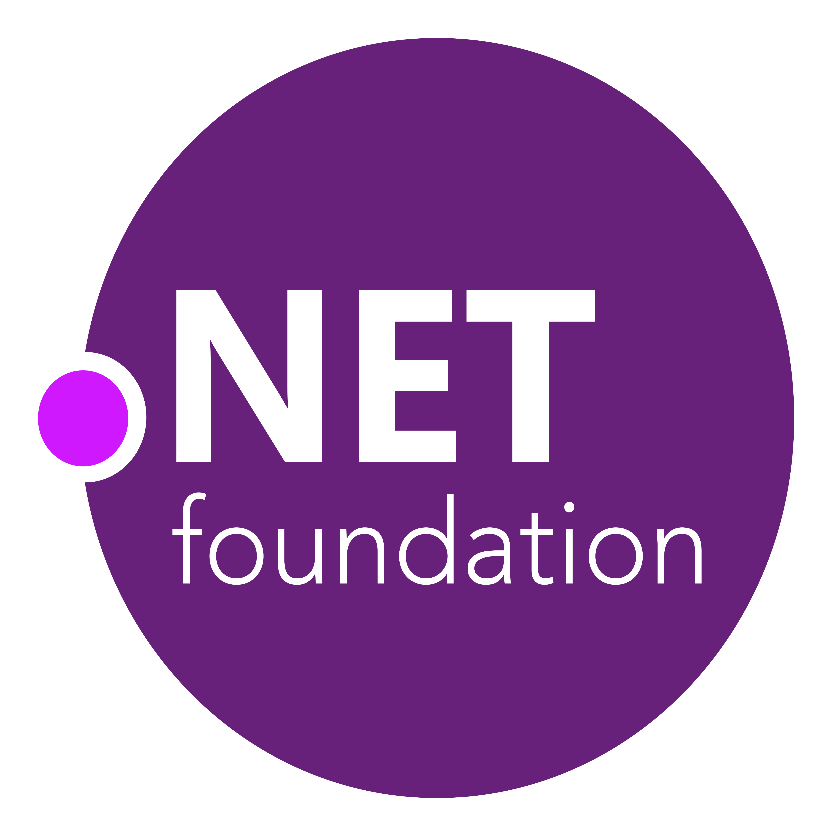
87% contributors outside Microsoft
.NET open source momentum
61,000+ accepted PRs from community
Notes:
We’re proud of all the innovation in .NET Core and the surrounding ecosystem, but we’re also proud of its momentum in the open source community.
There are a number of open source projects that make up the .NET platform ecosystem, and it’s amazing to see the engagement. 87% of the people who contribute to the .NET platform don’t work at Microsoft.
And these open source developers have made over 61 thousand code contributions back to the platform.

Slide 16
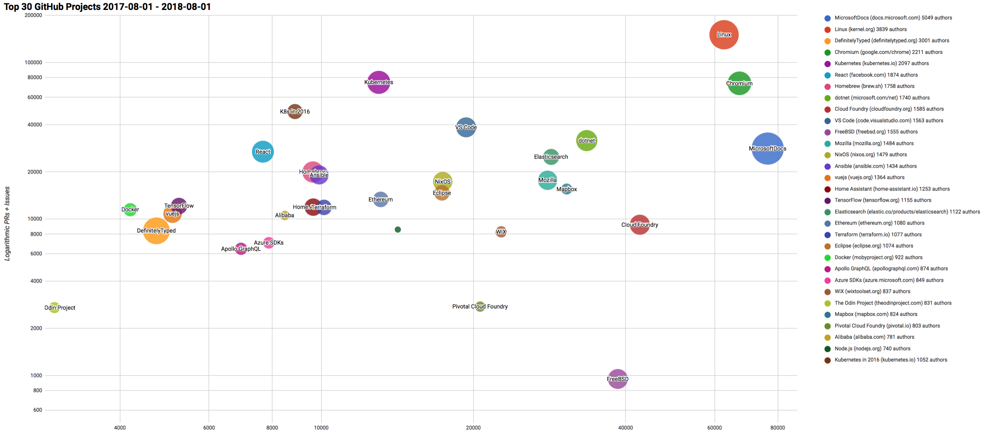

Top 30 Highest Velocity OSS Projects on GitHub
https://www.cncf.io/blog/2017/06/05/30-highest-velocity-open-source-projects/
https://raw.githubusercontent.com/cncf/velocity/master/charts/top30_20170801_20180801.png
Notes:
Jim Zemlin, Executive director of Linux foundation said “There are 10’s of millions of open source projects, invest in the ones with sustainable ecosystems”. .NET is one of those projects. CNCF tracks the top 30 highest velocity open source projects. This is a logarithmic scale to measure OSS project velocity with commits on the X axis and PRs and issues on the Y axis, with # of authors indicated by the size of the circle. The farther upper right the more activity a project has. Linux Kernel is #1, followed by Chromium, Kubernetes and Microsoft Docs. Notice .NET is the #1 application framework.

Slide 17

.NET Open Source Journey
.NET
2001
ECMA 335
2008
ASP.NET MVC (web platform) open source
April 2014
.NET Compiler Platform (“Roslyn”) open source
.NET Foundation founded
2016
Mono project joins .NET Foundation
Dec. 2018
.NET Core 2.2 released.
.NET Core 3.0 preview WinForms and WPF go open source
2002
NET 1.0 for Windows released. Mono project begins
Aug. 2017
.NET Core 2.0 released
Nov. 2014
.NET Core (cross-platform) project begins
Notes:
<talk to the journey, key milestones below>
Dec 2001-Feb 2002.
A new platform is born. Along with HP, Intel and others, the ECMA-335 standard was created that defined a common language infrastructure to support multiple programming languages. C# and Visual Basic.NET were released and F# came later in 2007, but there are over 20 other .NET languages today. Visual Studio .NET was released and included C#, VB, C++ development all in one box. This was the first IDE that was truly integrated across multiple languages.
Mono project begins. The CLI spec gave others the ability to create their own .NET implementations. Even though Microsoft built the first .NET Framework for Windows-only, the spec was intentionally portable across OSes and chipsets. The Mono project began, spearheaded by Miguel de Icaza, with the goal to implement Microsoft's new .NET development platform on Linux and Unix-like platforms. Later, Miguel started Xamarin which focused on cross-platform, native, mobile development with C#, built upon Mono. This allows developers to use C# and .NET to build apps for iOS and Android. Unity games development also emerged from Mono.
2008.
ASP.NET MVC web development stack is released to CodePlex as open source. This was the first application development framework from Microsoft to be released as open source. The underlying runtime and compilers were still closed however.
2014.
Hell freezes over & pigs fly. Early 2014 at Microsoft’s BUILD conference, Anders Hejlsberg, the father of C#, releases the .NET Compiler Platform “Roslyn” as open source on stage. Later in November, .NET Core project begins in the open. The technology world is shocked, and the .NET community is excited. .NET Core is a new cloud-native implementation of .NET that is geared for cross-platform, hyper-scale services as well as small IoT devices. It’s meant to bring .NET into the next 15 years of computing. And the community has been extremely supportive….
2016.
Mono comes home. In early 2016, Microsoft finally acquires Xamarin and brings Miguel de Icaza into Developer Division. Mono joins the .NET foundation and is officially supported and contributed to by Microsoft. The Microsoft community officially meets the Mono community.
2017.
.NET Core 2.0 Released. Our cross platform and open source implementation of .NET finally releases to the world with unified tooling support across multiple operating systems and editors.
2018.
Winforms and WPF go open source. At Microsoft Connect 2018 we announced the open sourcing of Windows Forms and WPF desktop frameworks. We’ve seen incredible contributions and activity since. The community now has the power to guide the direction of these frameworks. We also released .NET Core 2.2 and .NET Core 3.0 preview

Slide 18





.NET Core
3
2
.NET Core 3 expands supported workloads to include Windows Desktop, IoT & AI
.NET Core is perfectly suited for the requirements of cloud-native, cross-platform workloads
WEB
CLOUD
DESKTOP
IoT
AI
.NET CORE
.NET CORE 3
LIBRARIES
INFRASTRUCTURE
RUNTIME COMPONENTS
COMPILERS
LANGUAGES
Notes:
<ANIMATED SLIDE – shows progression of entire .NET platform into .NET Core specific workloads.>
.NET Core is our cross-platform, open source implementation of .NET and is perfectly suited for requirements of cloud-native, cross-platform services. We’ve made significant investments in the core performance as well as the web stack so that you can easily take advantage of cloud patterns and scale.
.NET Core 3 will expand on the supported workloads to include IoT, AI/ML and Windows Desktop.

Slide 19

.NET Core 3.0 themes
Desktop Workloads
& UI Interop
Artificial Intelligence & Machine Learning
Web App Development Productivity & Microservices
Notes:
Desktop workloads – Windows Forms, WPF and WinUI library for UWP will be supported with .NET Core 3 as well as being able to interop with modern native UI controls via XAML islands. For instance, a WinForms app will be able to use the modren browser control in Windows 10.
We're also working hard to bring you a high-performance Machine Learning framework for .NET developers to build custom ML Models, called ML.NET.
On the web-side, we'll be making it much easier to build web apps using reusable UI components.
Microservices will also be a big theme for .NET Core 3. We’re looking at additional patterns and templates for building these quickly.

Slide 20
The future of .NET Framework
.NET Framework is slowing down
Why? We want to stop breaking customers apps
Billions of installs. Getting much harder to release major features without compatibility issues
Can innovate much faster with .NET Core because of its side-by-side nature
We will continue to update
Many major product lines within Microsoft depend on .NET Framework
We will continue to update .NET Framework for years to come. High-compat features only.
Things like… new security protocols, bug fixes, Windows features, etc.
No changes to support policy
Support for 10 years (5 mainstream+5 custom) per Windows support policy for each release
.NET Framework will remain a Windows component and service policy is the same as Windows
Recommend new development on .NET Core

Slide 21


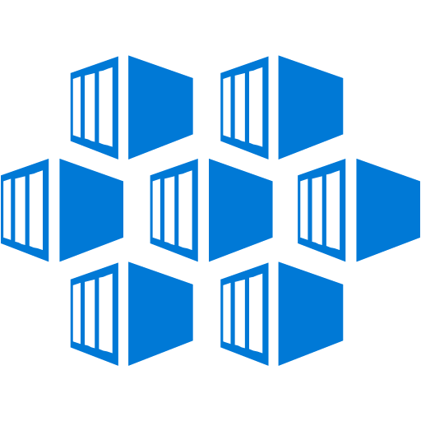







.NET cloud apps run best in Azure
Azure Storage
Azure App Service
Azure Functions
Azure Cosmos DB
Azure SignalR Service
Azure App Insights
Azure Service Fabric
Azure Virtual Machines
Azure Cognitive Services
Azure SQL Database
Azure Kubernetes Service (AKS)
And many more…
Extend apps with serverless, event driven tasks
Commoditized AI
Fully managed platform perfect for running .NET Framework and .NET Core web aps and services
Application performance and usability monitoring
Build native .NET, fully managed, scalable microservices
Relational Database
Non-Relational Database
Fully managed real-time web functions, like chat, gaming, tickers, collaboration and more
Store anything. Great for binaries
Container orchestrator for Linux workloads (.NET Core)
Notes:
Azure is the .NET developer’s cloud. There are hundreds of developer services accessible to .NET developers. From fully managed platform as a service with App Service, to serverless event driven Azure functions to relational and non-relational databases, the .NET developer is a primary target customer. We make developing against these services as integrated and productive as a .NET developer would expect.

Slide 22
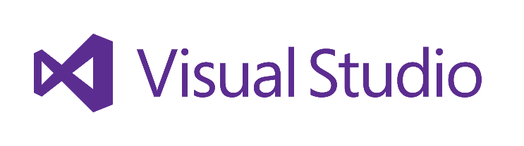
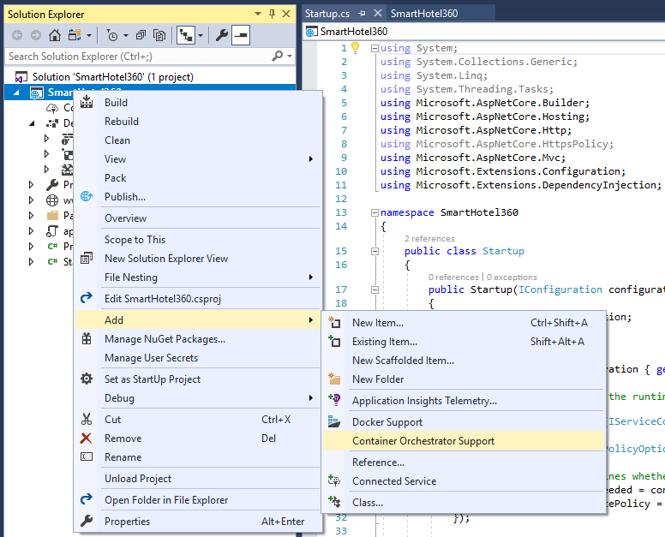
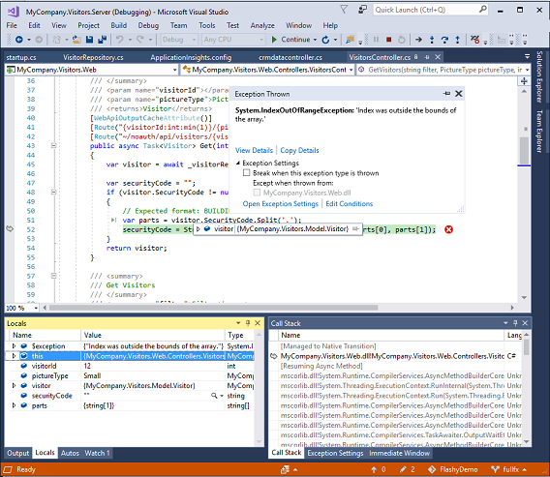
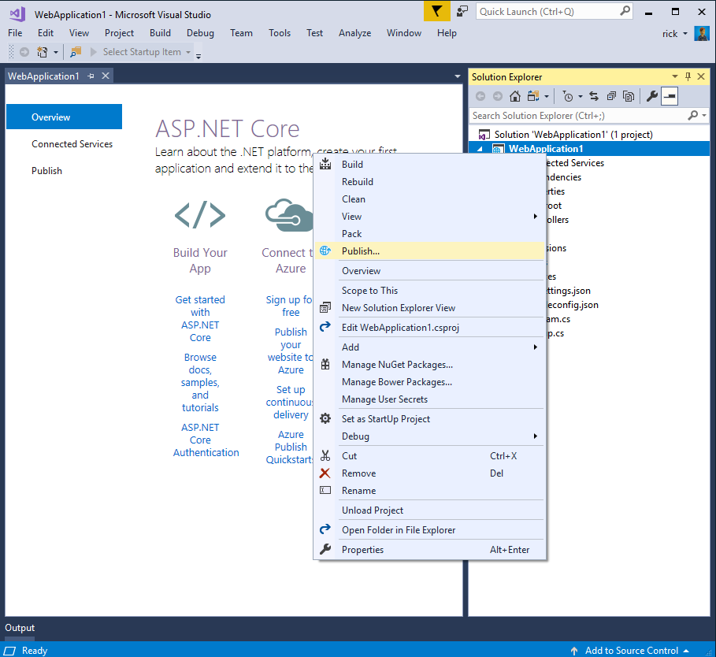
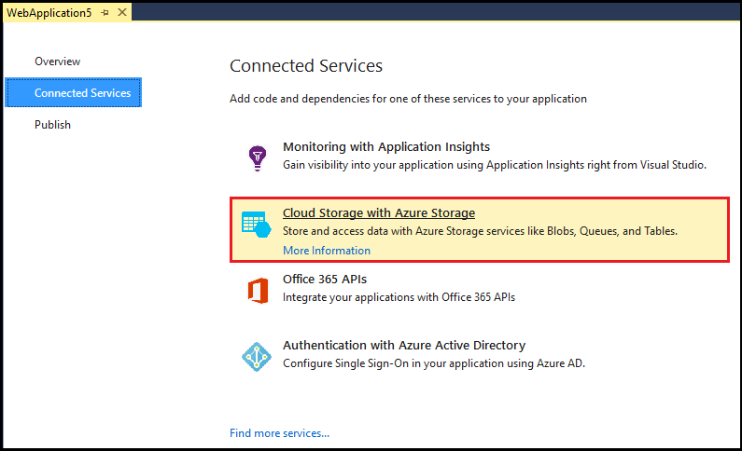
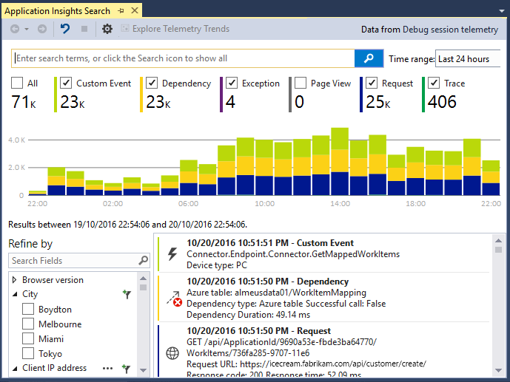
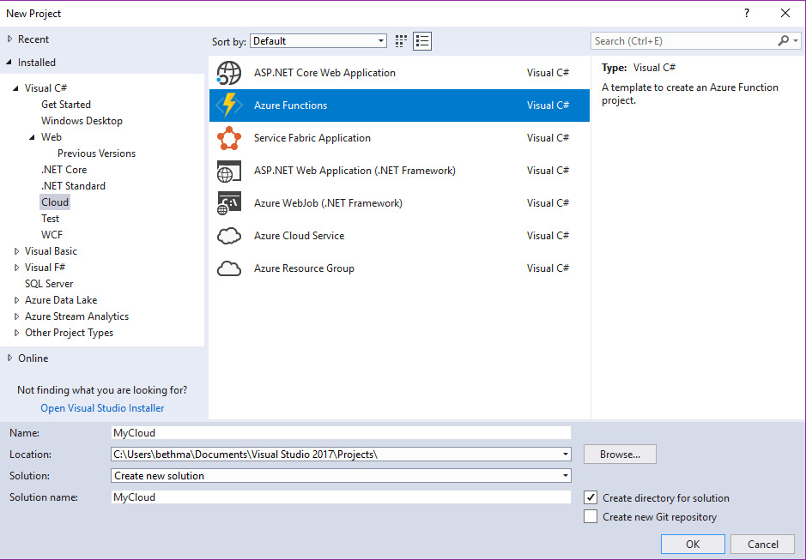
Accelerate your
development
cloud
Seamless Azure Integration
Publish directly to Azure without leaving the IDE
Connected Services
A new experience for easily discovering and extending your app with cloud services
Container Tools
Quickly add Docker compose and container orchestrator support to your apps
App Insights with Code Lens
Get a 360° view of your app that includes availability, performance and user behavior
Azure Functions
Get started quickly with serverless using templates and tools for development and debugging
Snapshot Debugging
Production debugging your cloud apps has never been so simple
Notes:
Of course there are a lot of great tools in Visual Studio for building applications. But what’s even better is the latest tools for building, monitoring, and managing your cloud applications. Whether that’s web applications hosted in App Service, or serverless Azure functions with C#, or containerized apps with Docker, we have you covered.

Slide 23
Migration & modernization strategies

Slide 24
Ro to tweak
Cloud migration vs. modernization
Migrate
Modernize
Description
Redeploy as-is to cloud
Minimally alter to take better advantage of cloud
Materially alter/decompose application to services
New code written with cloud native approach
Reduce Capex
Free up datacenter space
Quick cloud ROI
Faster, shorter, updates
Code portability
Greater cloud efficiency (resources, speed, cost)
App scale and agility
Easier adoption of new cloud capabilities
Mix technology stacks
Accelerate innovation
Build apps faster
Reduce operational cost
Drivers
PaaS
Containers
PaaS
Serverless
Microservices
Technologies
IaaS
Results
IaaS: 435% ROI, 73% reduction in datacenter footprint and 83% reduced IT outsourcing cost.¹
PaaS: 466% ROI, 80% time saved, 5.91M NPV, 50% faster deployments.¹
Container: 13x more releases, 10x cost reduction, 65% faster developer onboarding, 62% better availability. ²
Notes:
Gartner: Developing a Public Cloud IaaS Adoption and Migration Framework, published March 2017.

Slide 25
Migrating to the Cloud, Use Cases
Hosting existing ASP.NET web apps, APIs & WCF services on Azure
Cloud Infra Ready | Cloud Optimized Containers | Cloud Optimized
IaaS (Virtual Machine) | Windows Containers (App Service, Service Fabric, ACI, VM with Windows Containers) | PaaS (App Service)
No re-architect or new code Least effort for quick migration Similar deployment model to on prem | No re-architect, minimal code or config settings change Improved deployment and DevOps agility because self contained dependencies Automatic deployment with CI/CD High availability and scalability with Orchestrators Portability of apps through containers/docker, multi-cloud enabled | No infrastructure to manage Built-in high availability, scaling, and security Multiple versions of .NET supported Automatic deployment with CI/CD Advanced monitoring, diagnostics and debugging
Manual patching and upgrade Manual scaling and availability | Containerization has a learning curve | Not all apps are eligible May require some code refactoring
Notes:
<walk through pros/cons of each type of architecture>
Most ASP.NET Websites, Web APIs and WCF services that are based on the .NET Framework for Windows can be hosted in App Service with minimal to no changes. Developers can move their existing .NET apps to the cloud first then look at refactoring and modernization to .NET Core. The cloud optimized (PaaS) option is what this deck will focus on.
<Note: AKS – Azure Container Service for Kubernetes (the managed service) does not yet have Windows support, but it is coming soon.>

Slide 26
.NET Framework migration:
Try App Service

Slide 27
App Service differentiator
High productivity
Fully managed
Enterprise grade
Benefits of App Service for .NET Developers
Live production debugging with Visual Studio Snapshot Debugger
App telemetry, anomaly detection, and site diagnostics with App Insights
Automatic OS and framework patching (.NET Framework & .NET Core)
Site staging slots
Continuous integration/deployment with Git, Visual Studio, Docker Hub, and GitHub
Site extensions support & gallery
Auto-healing
Logging and auditing
Admin-site
Automated deployment
AutoScale
Built-in load balancing
WW datacenter coverage
End point monitoring and alerts
App gallery
DR site support
WildCard support
Dedicated IP address
HTTP compression
CDN support for websites
App Services Environments
Hybrid connections/VPN support
Scheduled backup
Azure Active Directory Integration
Site resiliency, HA, and DR
Web jobs
Role base access control
Audit/compliance
Enterprise migration
Client certs
Cache
IP restrictions/SSL
Web sockets
SQL, MySQL, CosmosDB
Sticky sessions
Authorization/authentication
Notes:
For .NET developers there are even more productivity benefits, particularly when developing apps with Visual Studio and Application Insights. This includes live production debugging via snapshots & snappoints, advanced telemetry with Application Insights, and team development with CI/CD and integration to Azure DevOps.
Benefits of App Service for .NET developers
Application Insights
Monitoring is a big part of App Modernization - understanding which features are the most used, which pages are the most visited or what is causing the most failures will help the development team to focus more on those elements. Application Insights is an extensible Application Performance Management (APM) service for web developers on multiple platforms. Use it to monitor your live web application. It will automatically detect performance anomalies. It includes powerful analytics tools to help you diagnose issues and to understand what users actually do with your app.
Snapshot Debugger for .NET
Debugging apps can be difficult specially if the app is running on production with Snapshot Debugger you can take a snapshot of your in-production apps when code that you're interested in executes. The debugger lets you see exactly what went wrong, without impacting traffic of your production application. The Snapshot Debugger can help you dramatically reduce the time it takes to resolve issues that occur in production environments.
DevOps optimization
Setting up a Continuous Integration and Continuous Deployment (CI/CD) with Visual Studio Team Services, GitHub, BitBucket, Git, FTP, Dropbox or OneDrive have been never so easy. Azure App Services will setup the right configuration for your build definitions from your source control to your Azure App Service with the Build Provider.
Automatic OS and .NET Framework patching
Because you’re using a fully managed platform, you don’t manage your own infrastructure at all and benefit from automatic OS and framework patching.
Site Staging Slots
When you deploy to App Service, you can deploy to a separate deployment slot instead of the default production slot. This allows you to validate app changes in a staging environment before swapping it with the production slot. The traffic redirection is seamless, and no requests are dropped as a result of swap operations. This entire workflow can be automated.
Global scale with high availability
One of the most challenges things when we have to manage infrastructure is setting up the scalability needed for our apps. Business should run without systems failures no matter how can it grow. With App Services you can scale up or out, manually or automatically. Host your apps anywhere in Microsoft's global datacenter infrastructure, and the App Service SLA promises high availability.
Security and compliance
App Modernization requires security and compliance and Azure App Service provides ISO, SOC, and PCI compliant. We can choose to authenticate users with Azure Active Directory or with social login (Google, Facebook, Twitter, and Microsoft). Create IP address restrictions, manage service identities, add custom domains and SSL to your apps, as well backups you can create restorable archive copies of your apps content, configuration and database.

Slide 28
What types of .NET apps are ideal for App Service?
ASP.NET
Webforms, MVC, Web API
WCF services
Http / Https bindings *
Self contained monolithic/N-Tier web apps & services talking to a database are particularly well suited for Azure App Service as well as apps that do not have complex dependencies.
* Supported WCF bindings: BasicHttp, WSHttp, NetHttpBinding, NetHttpsBinding, BasicHttpContextBinding, WebHttpBinding, WSHttpContextBinding

Slide 29

Compatibility Checklist – Can my .NET app move?
 | Checklist
 | Ensure port bindings 80 (Http) or 443 (Https)
 | Anonymous & forms authentication supported. Windows auth with Azure Active Directory or ADFS & VPN
 | No GAC (Global Assembly Cache) usage
 | Single Application Pool per site
 | IIS7+ Schema Compliance
 | No COM/COM+ components
 | No reference to physical directories. Use blob storage to mimic file access.
 | Verify access to on-premises resources as they may need to be migrated/changed
 | SQL Server, Oracle, MySQL databases
 | ISAPI Filters DLL(s) need to be deployed locally and registered via web.config
Follow this checklist to determine if the app needs some refactoring
Notes:
Port Bindings: Only port 80 for HTTP and port 443 for HTTPS traffic is allowed
Authentication: Anonymous authentication supported by default and Forms authentication when intended. Windows authentication can be used by integrating with Azure Active Directory and ADFS.
No assemblies in the GAC (Global Assembly Cache): Consider local copy assemblies to \bin. Custom .MSIs installed on the server cannot be used.
IIS7+ Schema Compliance: Not all elements and/or attributes of the IIS Schema is supported. Consider using XDT transforms.
http://azure.microsoft.com/en-us/documentation/articles/web-sites-transform-extend/
Single Application Pool Per Site: Each Web App and all of the applications under it run in the same worker process with a specific set of application pool settings. If you are using multiple pools, consider establishing a single application pool with common settings or create a separate Web App for each application. IIS5 Isolation Mode is not supported.
No COM and COM+ components: The registration of COM components on the platform is not allowed. If your site(s) or application(s) make use of any COM components, these would need to be rewritten in managed code and deployed with the site or application.
No Physical Directories: Physical drive access is not allowed. You may need to use a storage account to mimic access to files/blobs.
On-premises Resources: Verify access to on-prem/physical resources as these will likely need to be migrated/changed. Other dependent services may need to also be migrated to App Service, or set up Azure Relay service for hybrid apps. (SEE DEMO) https://docs.microsoft.com/en-us/azure/service-bus-relay/relay-what-is-it
Databases: SQL Server supported via Azure SQL Database & SQL Server on Azure VMs. Oracle and MySQL also supported.
ISAPI Filters: Use of ISAPI Filters is supported. The DLL(s) need to be deployed with your site and registered via the web.config.

Slide 30
.NET Core modernization:
Phased approach to Cloud-Native

Slide 31


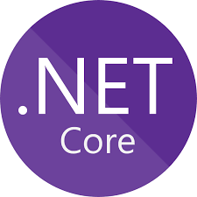

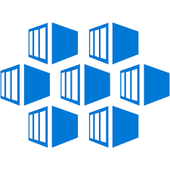








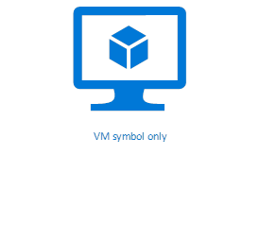






Maturity model for .NET application modernization
Existing apps
.NET web apps (on-premises)
Cloud
Infrastructure-Ready
Cloud-Optimized
PaaS
Cloud-Native
PaaS for microservices and serverless
Monolithic / N-Tier
architectures
Monolithic / N-Tier
architectures
Monolithic / N-Tier
architectures
Microservices and serverless architectures
Relational Database
IaaS
(Infrastructure as a Service)
Managed services
VMs
PaaS for containerized microservices
+ Serverless computing
+ Managed services
And Windows Containers
On-premises
Azure
Azure
Azure
Base Cloud Environment and cross-cutting concerns: Network, Hybrid-cloud, Identity/Auth, Cost control and Operations model
Migrate / Rehost
Modernize
Minimal code changes
Architected for the cloud, new code
Notes:
What’s next?
Modernize applications with .NET Core
Many applications will benefit from modern architecture built on .NET Core – a much faster, modular, cross-platform, open source .NET. Websites can be modernized with ASP.NET Core to bring in better security, compliance, and much better performance than ASP.NET on .NET Framework. .NET Core also provides code patterns for building resilient, high-performance microservices on Linux and Windows.

Slide 32
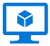







Azure Services Recommendations for .NET Apps
Azure Services
 | Azure Virtual Machines (VMs) | Azure App Service | Azure Kubernetes Service (AKS) | Azure Functions | Azure Batch | Azure Container Instances (ACI)
Web apps (Monolithic architecture)
N-Tier apps (Coarse-grain services)
Cloud-Native (Microservices architecture)
Batch / Jobs (Background tasks)
Recommended
Application
Architecture
Recommended
Recommended
Recommended
Azure
event-driven
Recommended
Application’s
background tasks
Recommended
Large Batch scale
Recommended
Recommended
Possible
Notes:
As you look to modernize with .NET Core and microservice / serverless / event driven architectures, there are more options and recommendations. Here they are.
Service Sweet spots
Azure Container Instances
Run individual containers with no VM management
Azure App Service Web Apps
Deploy scalable web apps and services (with or without using containers)
Azure Kubernetes Service (AKS)
Use leading OSS orchestrator and associated CNCF tools to deploy and manage containers
Azure Batch
Schedule large scale batch processes deployed in containers

Slide 33
Migration & modernization case studies

Slide 34

Customer themes
Data Center modernization
Cloud Lift and Shift
Application transformation
Expand application scenarios
Cross platform
Containers + Microservices
Cloud Native

Slide 35
Application migration

Slide 36
ASP.NET to App Service
Problem
Customer wants DevOps agility & App scalability
App has to stay on .NET Framework (i.e. WebForms, WCF)
Monolithic or n-tier (course grained services)
Solution
Migration to App Service with minimal code changes

Slide 37
.NET Framework containerization
Problem
App has dependencies on Windows/.NET Framework (i.e. GAC, MSIs)
Monolithic or n-tier (course grained services)
Solution
Windows Containers
App Service w/ Windows Containers
AKS

Slide 38
Application modernization

Slide 39


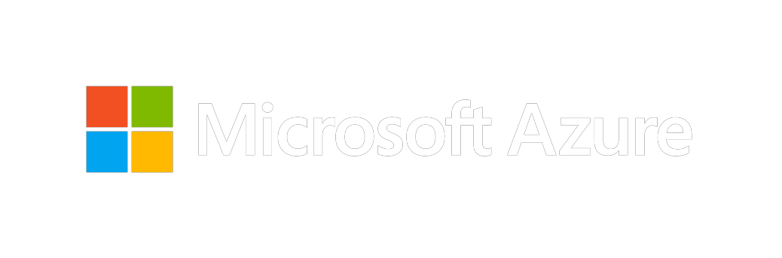
.NET Core Microservices on AKS
“Internal and external developers can independently release microservices at any point in time, which makes development faster and enables a continuous delivery approach completely based on Azure. We have set an astonishing speed for product development.”
Thomas Friese: Vice President, Digital Ecosystem Platform
Siemens Healthineers
Customer Story: https://aka.ms/SiemensCustomerStory

Slide 40
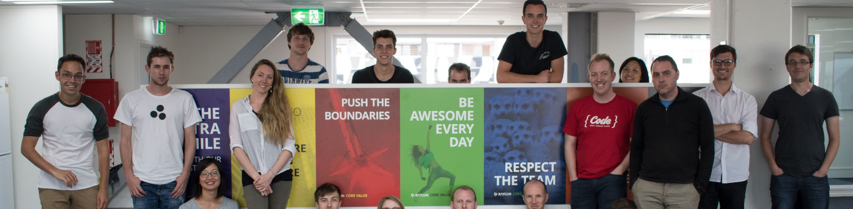

App performance monitoring provider increases throughput by 2,000 percent with .NET Core
The Raygun platform offers a cloud-based set of tools that help developers build better-performing, more reliable software. Its Real-User Monitoring and Crash Reporting applications provide developers with deep insights into problems that end users are experiencing, so they can diagnose and fix issues faster. By moving its API nodes, which run on Linux, from Node.js to .NET Core, Raygun increased its request throughput from 1,000 to 20,000 requests per second per node, increasing scalability and reducing the number of nodes required.
Products & Services
Org Size
Industry
Country
Business Need
Microsoft .NET Core Microsoft Visual Studio
40 employees
Telecommunications
New Zealand
Software error and crash reporting
Notes:
https://customers.microsoft.com/en-US/story/raygun

Slide 41

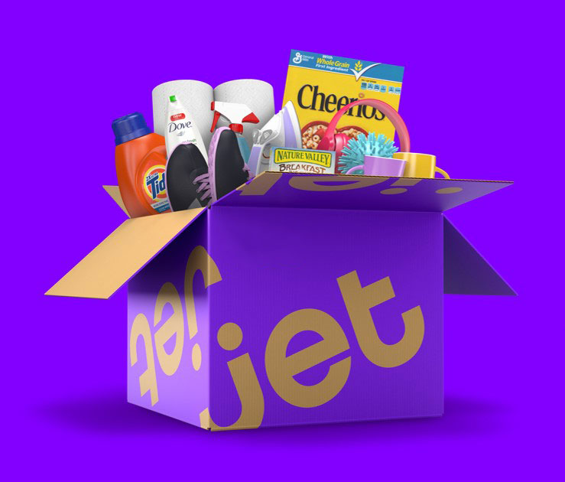
“To be one of the best e-commerce destinations in the US, we will have to handle millions of customers… That requires a top-class e-commerce system built on a flexible, open cloud platform. That is exactly what we got with Azure.
Being able to leverage so many off-the-shelf services and tools from Azure enabled us to go from zero to a full-fledged e-commerce marketplace in just about 12 months.”
Mike Hanrahan
CTO
Jet.com
Notes:
http://customers.microsoft.com/en-us/story/jetcustomerstory

Slide 42



Tencent updates web and mobile payment infrastructure for better scalability and agility
Tencent FiT, a division of Tencent and a global leader in online and mobile payment services, planned to modernize its IT infrastructure to accommodate rapid business expansion. The company migrated to a new back-end architecture based on .NET Core and ASP.NET Core. It now has an efficient API gateway for communication with payment settlement services, making them more scalable and maintainable and its development teams more agile.
Products & Services
Org Size
Industry
Country
Business Need
.NET Core ASP.NET Core
34,000 employees
Professional Services
China
IT Development
Notes:
https://customers.microsoft.com/en-US/story/godaddy-professional-services-net-core

Slide 43

GoDaddy ports communications services to Linux in six weeks using .NET Core
From building websites to hosting productivity tools, GoDaddy provides technology that helps small businesses succeed. As part of its goal to remain the go-to cloud platform for wide-ranging web services, GoDaddy acquired FreedomVoice in 2016 to enlarge the company’s portfolio of communication offerings. GoDaddy developers quickly and easily ported the acquired firm’s Microsoft .NET-based technology stack to .NET Core — a step critical to creating a new end-to-end business telephony solution running on Linux.
Products & Services
Org Size
Industry
Country
Business Need
.NET Core Microsoft Visual Studio .NET Framework
6,000 employees
Professional Services
United States
Platform services Data migration
Notes:
https://customers.microsoft.com/en-US/story/godaddy-professional-services-net-core

Slide 44
Migration & modernization resources

Slide 45
Get help moving .NET apps to Azure
Assess & Migrate
https://aka.ms/MigrateToTheCloud
The Azure Hybrid Benefit
Migrate your Windows Server and SQL Server-based web apps to Azure with your on-premises licenses
https://azure.microsoft.com/en-us/pricing/hybrid-benefit/
Microsoft Engineering Support
Migration Tools for Visual Studio Enterprise Subscribers
CAST Highlight - one full 30-day subscription up to 5 apps
CloudPilot - 2 licenses for 90 days, unlimited scans of 1 app per license
https://visualstudio.microsoft.com/subscriptions/
Notes:
Lift & Shift or Rearchitecting migration scenarios
.NET apps are Easy targets for quick on-ramp to cutting capital costs
Train teams on CI/CD, DevOps, automation, and overall cloud operations
Build a path to innovating apps: new experiences, AI, IoT and more
Migration offer -> other resources

Slide 46
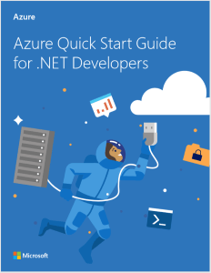
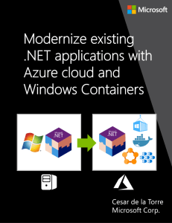
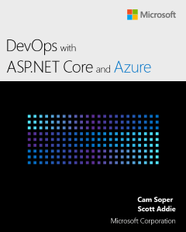
Get help migrating .NET apps to Azure
Download free e-books and assessment resources
aka.ms/migratetothecloud
Customers can apply for free assistance from the .NET team

Slide 47
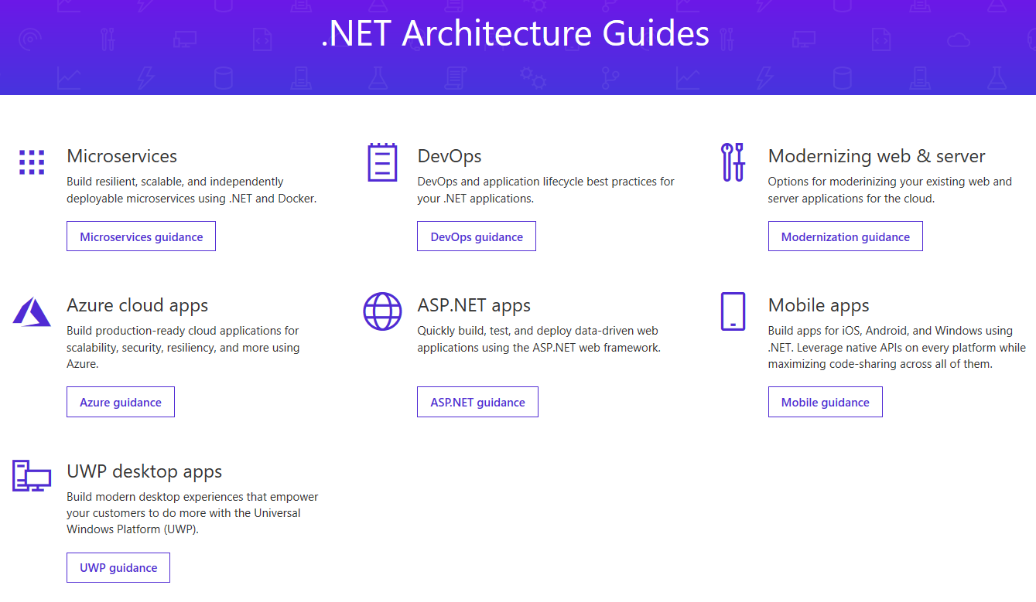
www.dot.net/architecture

Slide 48
Q&A
Notes:
Display this slide during session Q&A and direct attendees to use the Q&A microphone located in the session room:
Digital Ready session recordings cannot capture Q&A unless it is spoken using the microphone
Attendees in the back of the room may not be able to hear a question from someone in the front of the room
SPEAKERS MUST REPEAT THE QUESTIONS IF THE ATTENDEE IS NOT USING THE Q&A MICROPHONE

Slide 49
Resources
Docs, samples, e-books and request for free migration assistance from the .NET team
http://aka.ms/MigrateToTheCloud
Free .NET architecture guides and samples
www.dot.net/architecture
Azure migration center
https://azure.microsoft.com/en-us/migration/
Azure reference architecture guides
https://docs.microsoft.com/en-us/azure/architecture/guide/
This deck can be found at
https://github.com/dotnet-presentations/home

Slide 50
Thank you for joining us.
© 2018 Microsoft Corporation. All rights reserved. Microsoft, Windows, Windows Vista and other product names are or may be registered trademarks and/or trademarks in the U.S. and/or other countries.
The information herein is for informational purposes only and represents the current view of Microsoft Corporation as of the date of this presentation. Because Microsoft must respond to changing market conditions, it should not be interpreted to be a commitment on the part of Microsoft, and Microsoft cannot guarantee the accuracy of any information provided after the date of this presentation. MICROSOFT MAKES NO WARRANTIES, EXPRESS, IMPLIED OR STATUTORY, AS TO THE INFORMATION IN THIS PRESENTATION.

